Slide 1

Run 1 analyses end-game TOP PAG
TOP QUARK
CMS LHC Run-1
Rebeca Gonzalez Suarez on behalf of the CMS TOP group

Slide 2
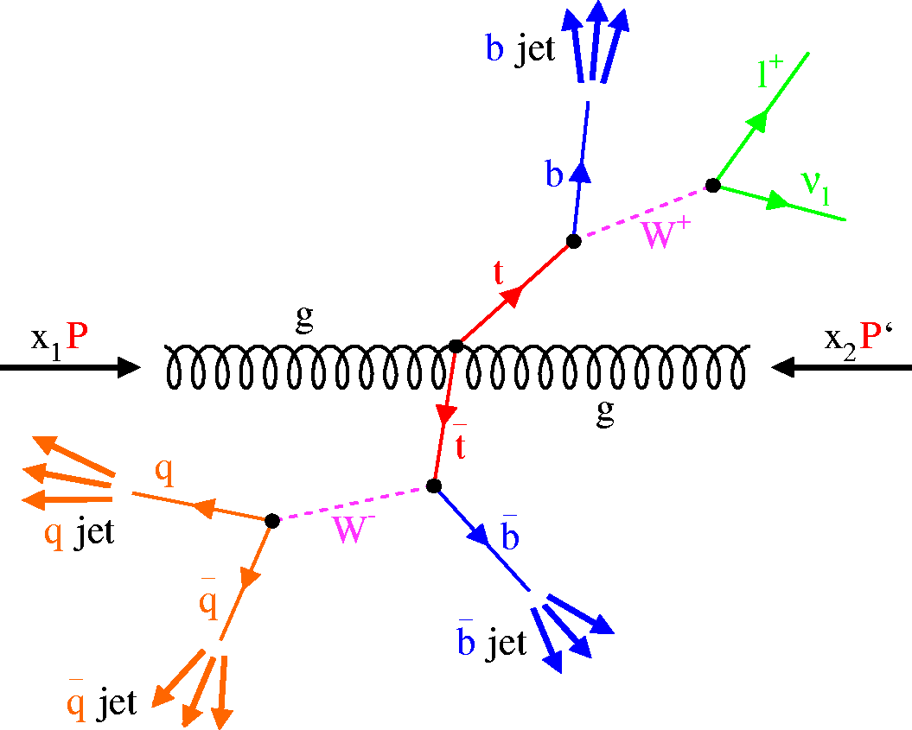
The top quark
“The top quark is special”
– Every speaker at every talk that covers top quarks
But it is indeed very special:
It is the heaviest elementary particle known
m_{top} = 173.34 GeV
But it is still point-like
It has a strong coupling to the Higgs boson
Hints a role on the electroweak symmetry breaking
m_{top} largely affects the stability of the Higgs mass
It is the only quark that decays before hadronizing
By studying its decay products we have direct access to properties (spin, charge, polarization)

Slide 3
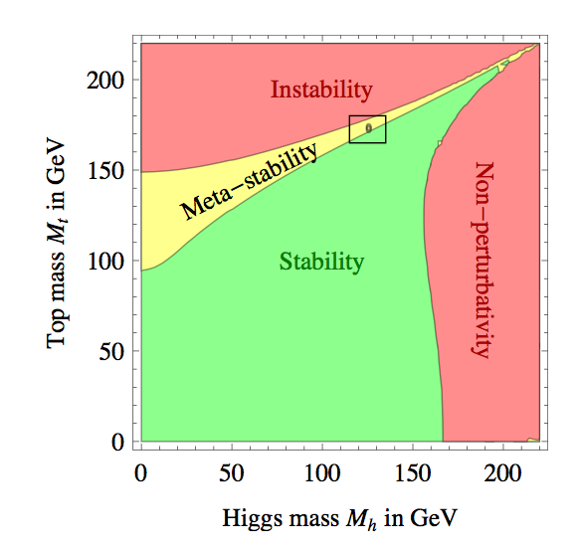
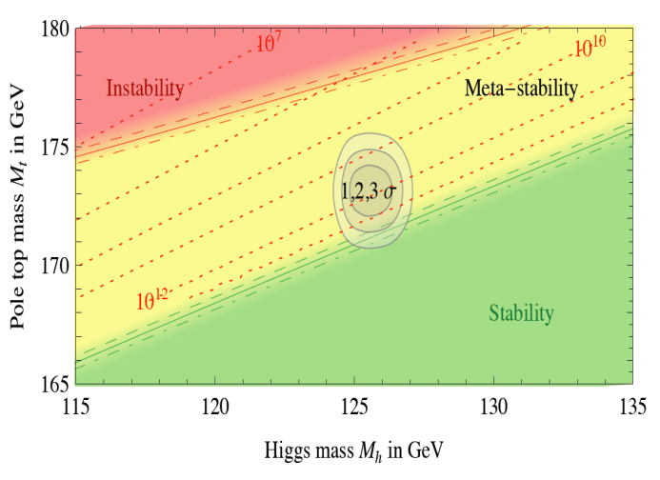
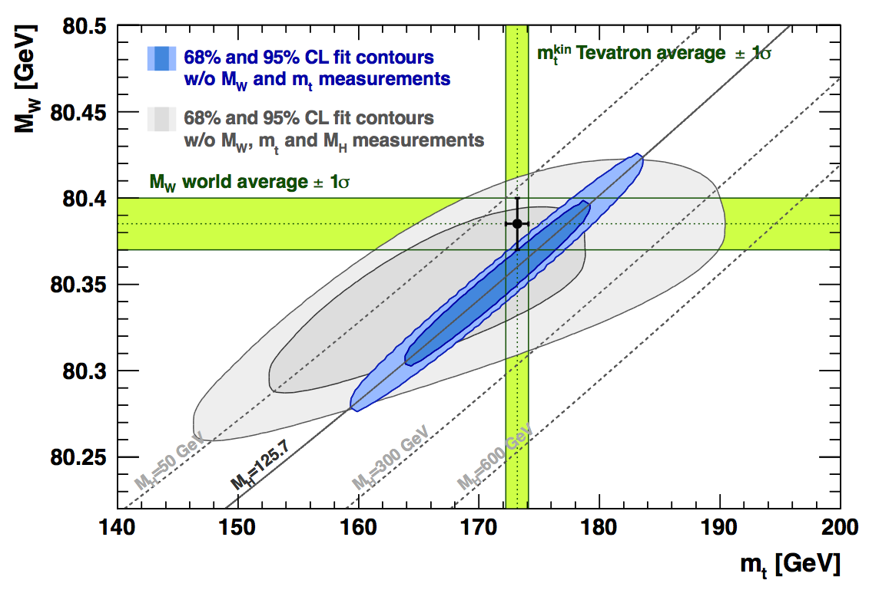
Top? Physics
→ Top is connected to QCD, EWK, flavor physics, and in particular Higgs
The top quark is key to explore the Higgs sector
→ Clear motivation for precision measurements (SM)
Mass, width, cross sections, differential distributions…
→ Top analyses require the development of tools and expertise useful beyond top
i.e b-tag
→ Natural way to go towards BSM physics (SUSY/EXO/B2G)

Slide 4
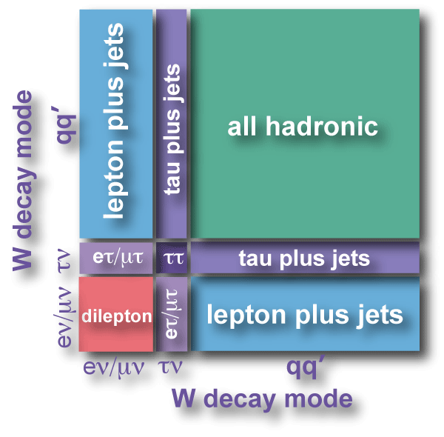
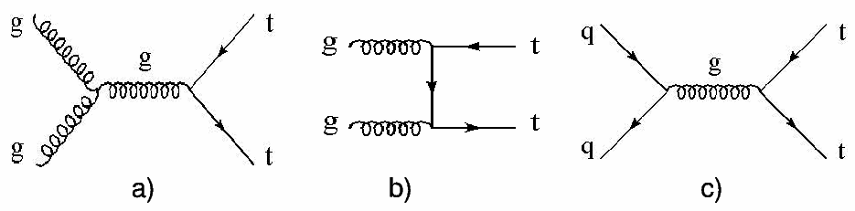
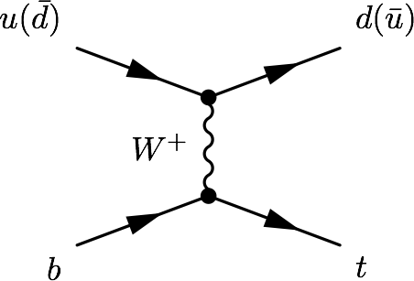
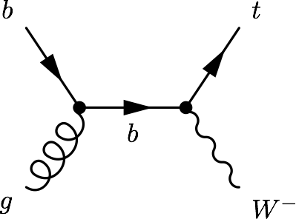
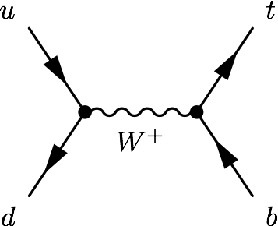
Top quark production
Main production mode:
→ ttbar pairs, via strong interaction (QCD)
In the SM:
t→Wb (~100%)
Alternative:
→ single top quarks (EWK production), much smaller rate
t-channel
tW
s-channel
σ [pb] | ttbar | t-channel | tW | s-channel
LHC (7 TeV) | 163 | 64.6 | 15.6 | 4.59
LHC (8 TeV) | 234 | 87.1 | 22.2 | 5.55

Slide 5
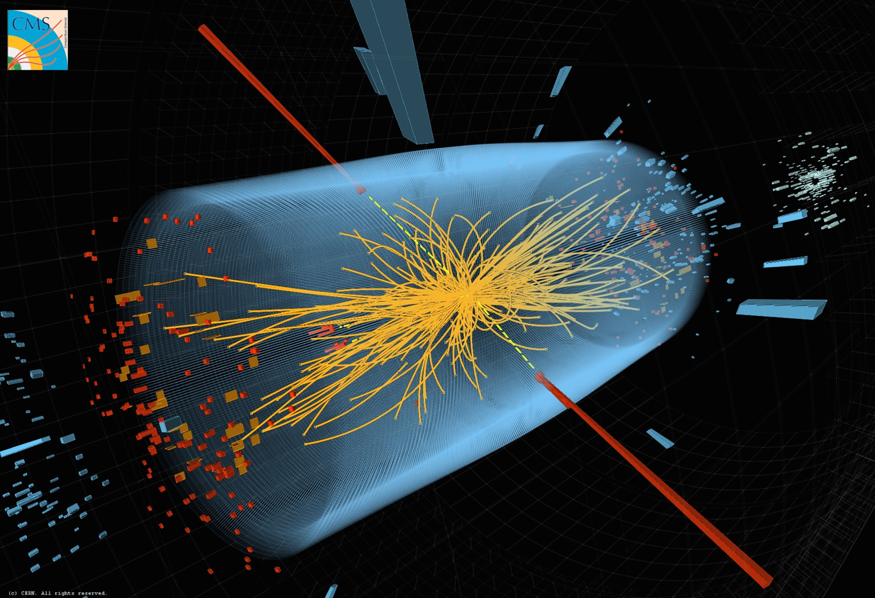

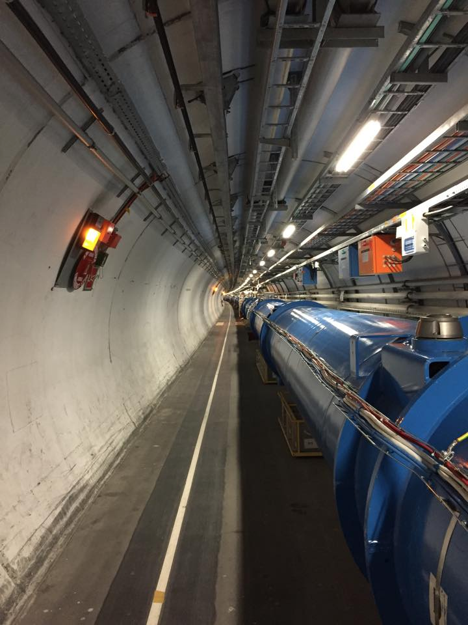

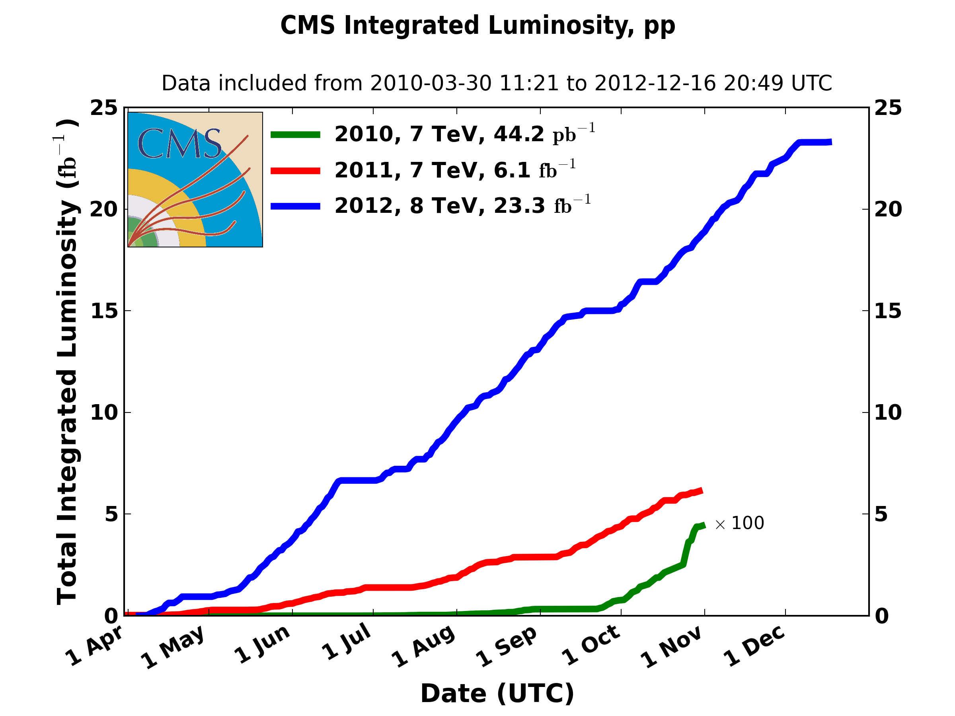
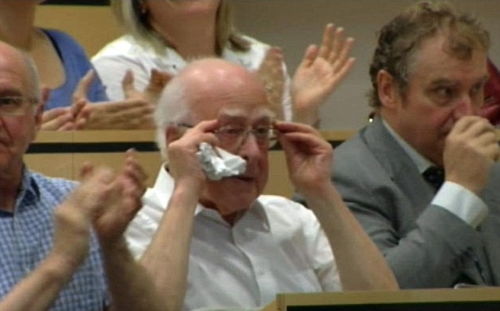
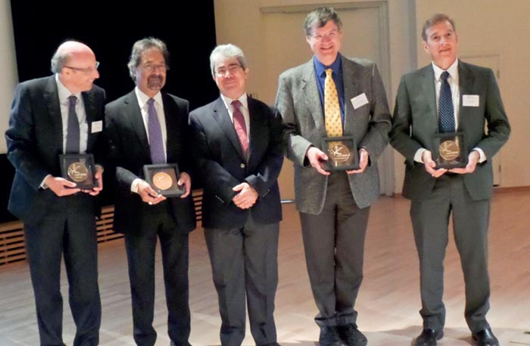
LHC Run 1 (2009 – 2013)
~5fb⁻¹@7TeV
~20fb⁻¹@8TeV

Slide 6
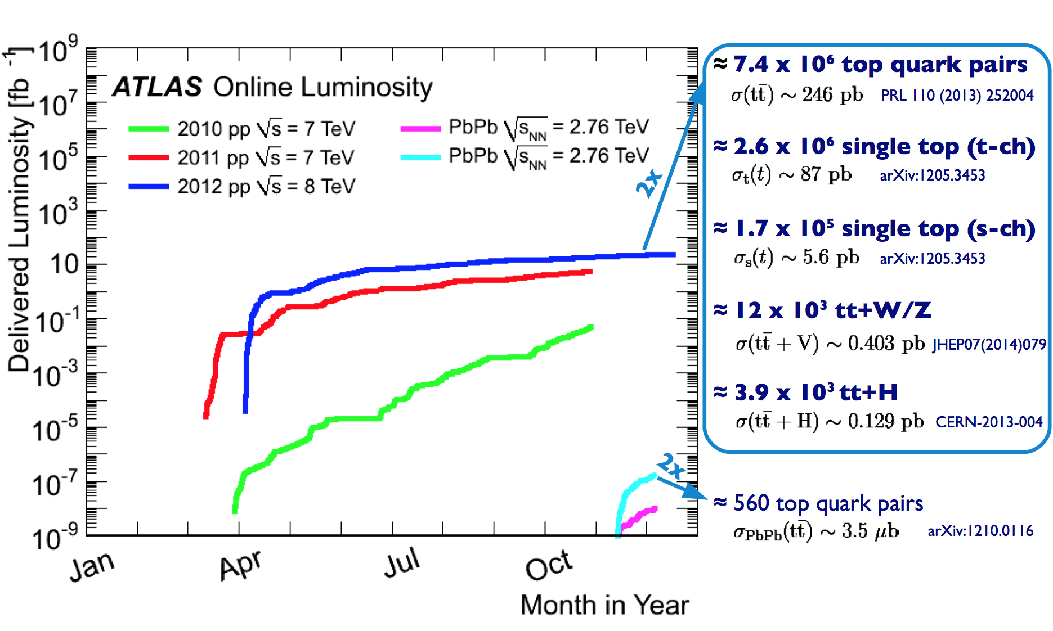

Run-1 in top quarks
t
t
t
t
LHC: Certified top factory
Stolen from Pedro’s talk on TOP2014 (slides)

Slide 7
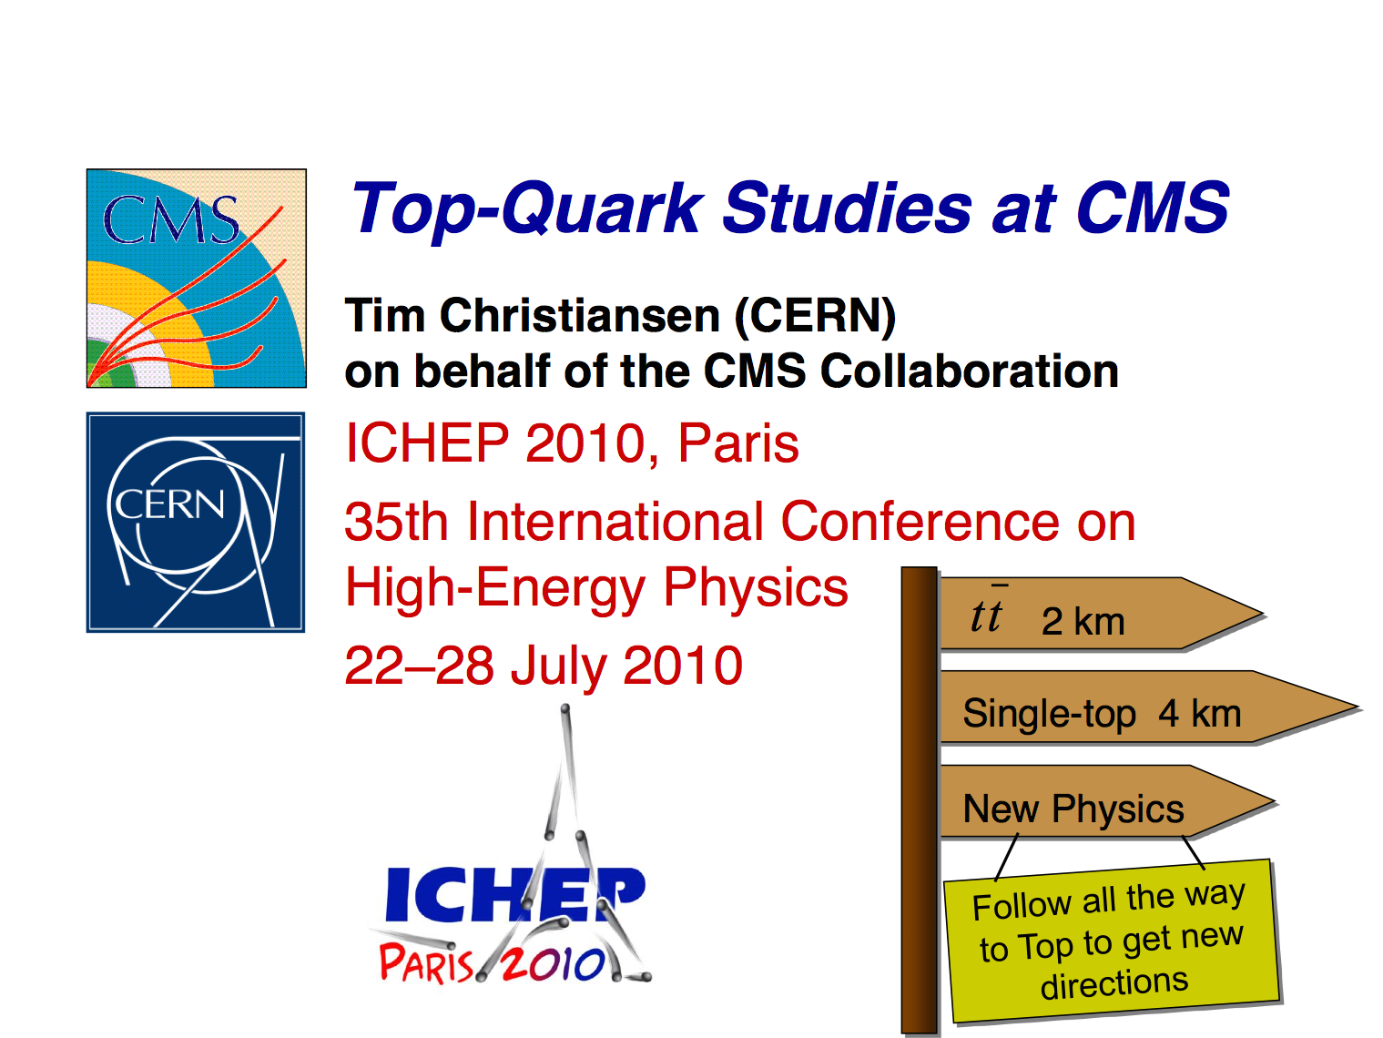
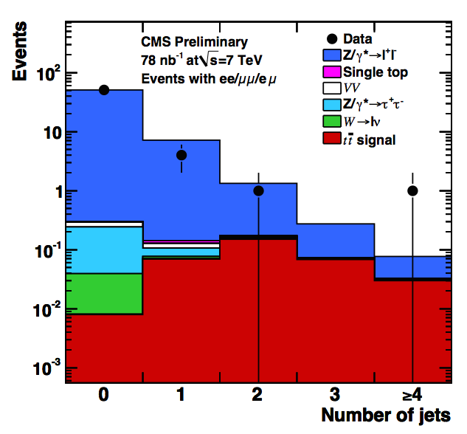
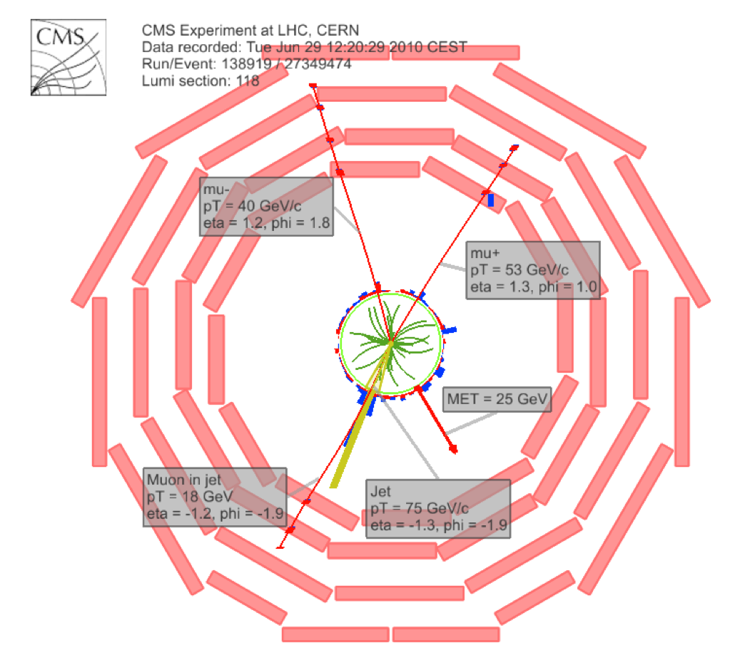
A bit more than 4 years ago…
‘Selection of Top-Like Events in the Dilepton and Lepton-plus-Jets Channels in Early 7 TeV Data’
A preliminary result with just 78.5nb⁻¹
ICHEP 2010 in Paris Featured
CMS PAS TOP-10-004
http://cds.cern.ch/record/1280706
Our first PAS with data

Slide 8

… and just some days ago
TOP 2014 in Cannes, France (28 Sep. – 3 Oct.) THE conference for top physics
https://indico.in2p3.fr/event/10114/
We presented several new results in TOP this year:
2 papers
TOP-12-020 arXiv:1410.1154 (submitted to JHEP)
TOP-13-012 arXiv:1409.7339 (submitted to JHEP)
6 PASes
TOP-14-014, TOP-14-004, TOP-14-015, TOP-14-009, TOP-14-016, TOP-14-010
CMS ruled the poster session
. James with TOP-13-012 (ex-aequo)
. Markus with TOP-14-001 ‘Palme d’Argent’
. Benjamin with TOP-13-007 ‘Palme d’Or’!

Slide 9
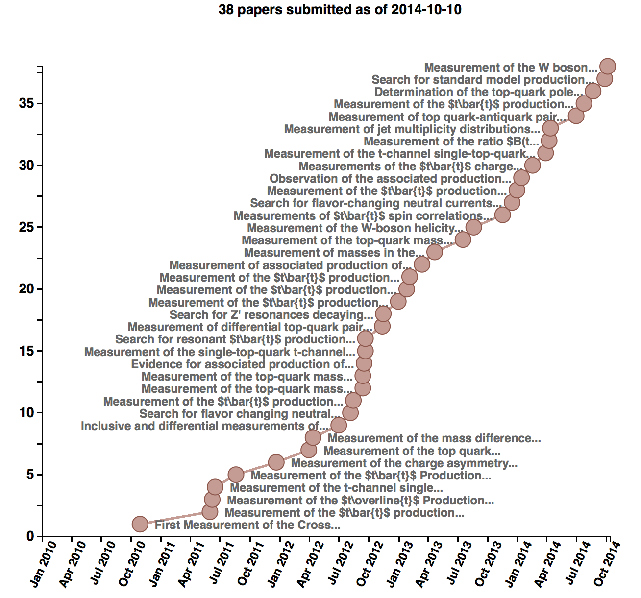
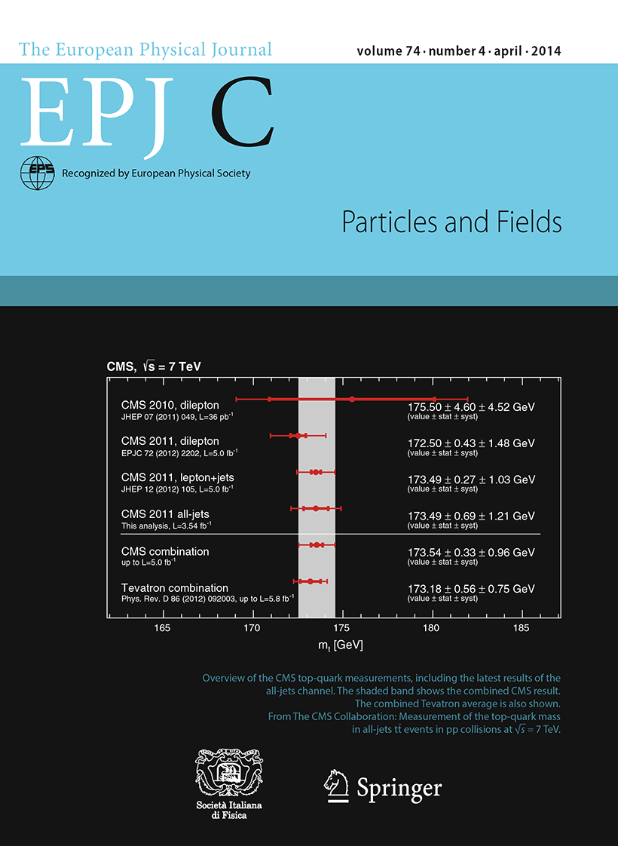
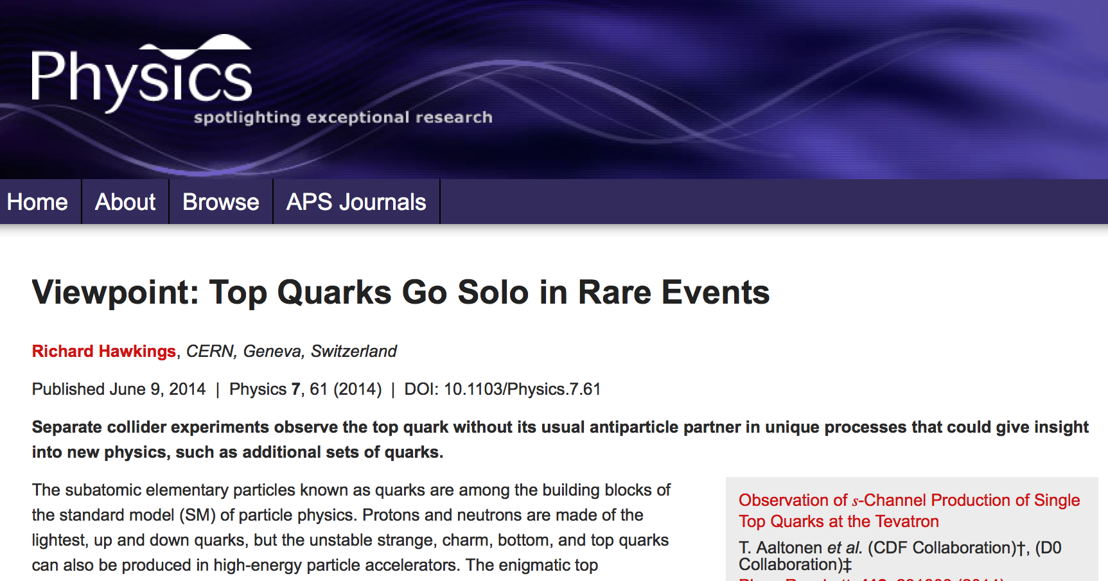
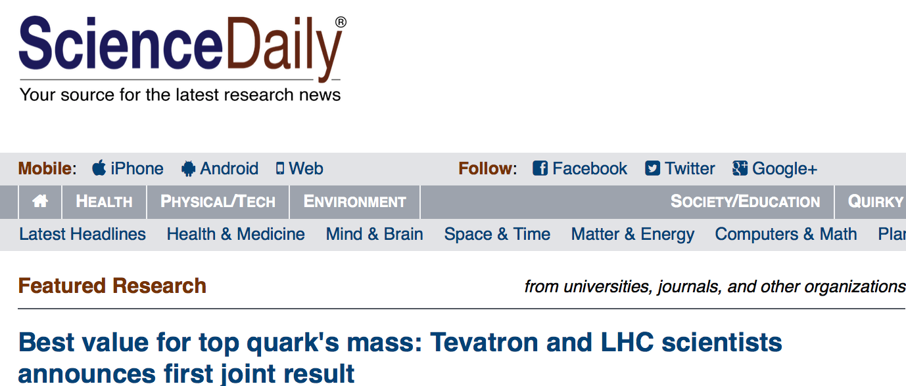
Some numbers
82 Public Analysis Summaries in cds
38 Papers submitted journals
36 of them already published
Planned ~38 more Run-1 publications
Most cases work already ongoing
1 FR, 2 post-CWR
~X2

Slide 10
Organization
Ending 2014
Starting 2015
The current top PAG conveners are
Martijn Mulders, Andreas Meyer, and Andrea Giammanco
TOP has at the moment 4 top subgroups:
cross sections: Akram Khan, Mara Senghi Soares, James Keaveney
mass: Pedro Silva, Benjamin Stieger, Hartmut Stadie
properties: Efe Yazgan, Jacob Linacre, Thorsten Chwalek
single top: Rebeca Gonzalez Suarez, Orso Iorio, Nadjieh Jafari
And works together with ATLAS and the theory community in the context of the TOP LHC Working Group
More info, including contact persons for different tasks and POGs:
https://twiki.cern.ch/twiki/bin/view/CMS/TWikiTopQuark

Slide 11
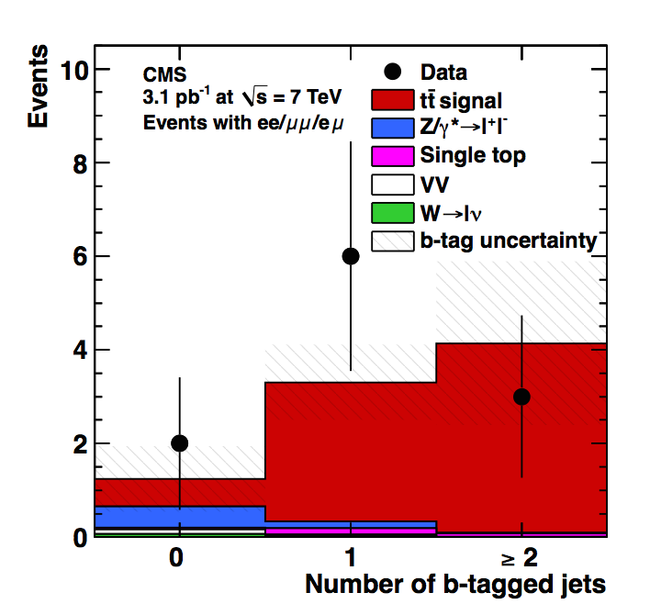
Top cross sections
October 2010
PLB 695 (2011) 424
arXiv:1010.5994
‘First Measurement of the Cross Section for Top-Quark Pair Production in Proton-Proton Collisions at sqrt(s)=7 TeV’
3.1pb⁻¹ dilepton (e,µ)
σ_{tt}=194±72 (stat.) ±24 (syst.) ±21 (lumi.) pb
First TOP paper

Slide 12
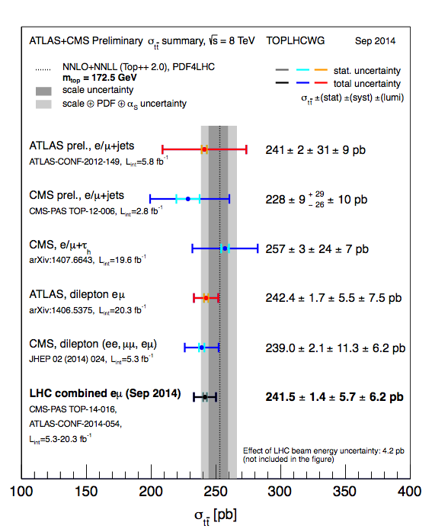
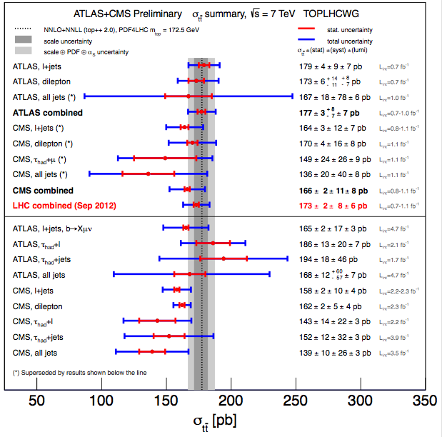
Inclusive
Cross sections
7TeV
8TeV

Slide 13
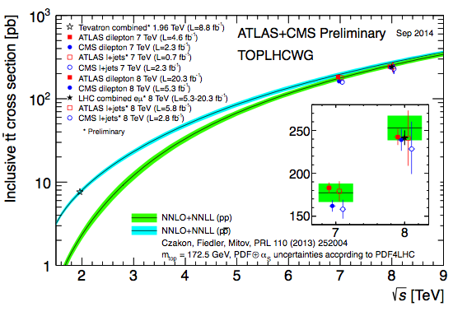
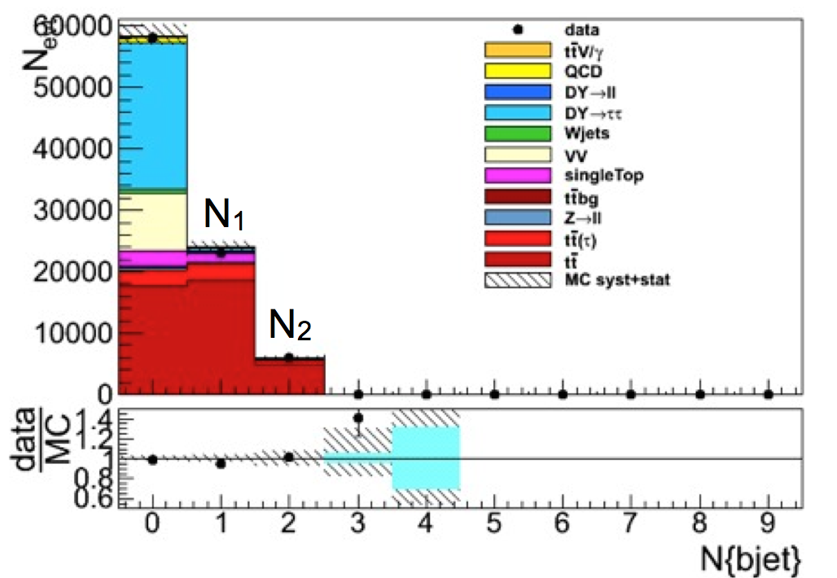
Inclusive Legacy 8TeV
Cross sections
8TeV HPA
dilepton published → legacy paper in preparation
l+jets preliminary → Extended paper draft in progress (TOP-12-006)
The legacy papers will include ratios, will focus on achieving the best precision possible
→ Dilepton (TOP-13-004) will include 1btag category to constrain b-tag systematics

Slide 14
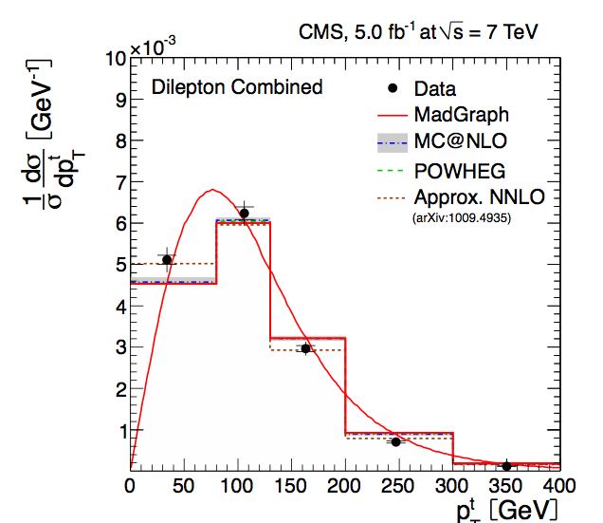
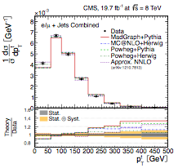
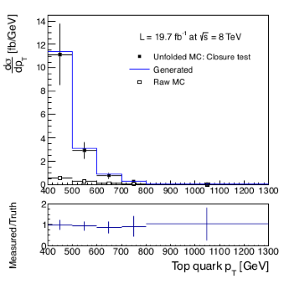
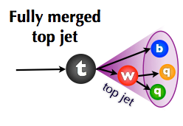
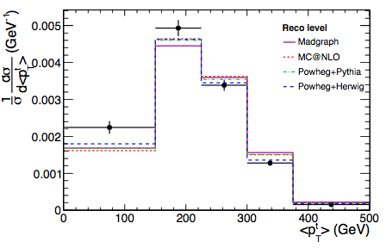
Differential
Cross sections
November 2012
EPJC 73 (2013) 2339
arXiv:1211.2220
Dilepton, l+jets
7TeV 5fb⁻¹
TOP-12-028
Post CWR
Dilepton 8TeV
First differential
Differential cross sections studied at 7 and 8 TeV, in all channels.
Slope discrepancy found at large p_{T} (confirmed by ATLAS), still to be understood by the theory → top p_{T} reweighting (widely used in top-related analyses)
in progress
All had.
TOP-14-018
in progress
Boosted top
TOP-14-012
New: Exploring directly large p_{T} (background free)

Slide 15
Publication plans
Cross sections
Inclusive cross sections (7TeV done):
TOP-12-006 Top pair cross section in e/µ+jets at 8 TeV (Fall 2014)
Legacy paper l+jets
analysis being finalized, paper draft in review
TOP-13-004 Legacy Run I inclusive cross-section including 8/7 TeV ratios (Fall 2014)
Legacy paper dileptons, full 2012 statistics, ultimate precision
Includes extraction of pole mass and limits on SUSY
Differential cross sections
TOP-12-028 ttbar Differential cross sections at 8 TeV (NOW)
dilepton and l+jets, paper draft post-CWR (includes TOP-12-027)
TOP-12-042 Measurement of MET, H_{T} and other global distributions in top pair events at 7 and 8 TeV (Fall 2014)
first paper draft available (includes TOP-12-019)
TOP-14-013 Double differential top pair cross-section at 8 TeV
analysis started

Slide 16
Publication plans (II)
Cross sections
TOP-14-018 ttbar inclusive and differential cross section in the fully hadronic final state
TOP-14-012 ttbar differential cross section in boosted topologies
Both analyses aiming for paper end of 2014
There are other analyses covered by top cross sections (tt+jets, ttbb…) that have provided very interesting public results, more to come:
TOP-12-041 Measurement of jet multiplicity in top pair events at 8 TeV (Winter 2014)
dilepton, preliminary since Spring 2013
TOP-XX-YYY 8 TeV tt+jets
l+jets, analysis starting
TOP-13-010 Measurement of ttbb cross section at 8 TeV (NOW)
dilepton, In Final Reading
TOP-13-016 Measurement of tt+bb in l+jets channel at 8 TeV (Fall 2014)
TOP-XX-YYY Pseudo-Top (RIVET optimized) differential cross-section analysis

Slide 17
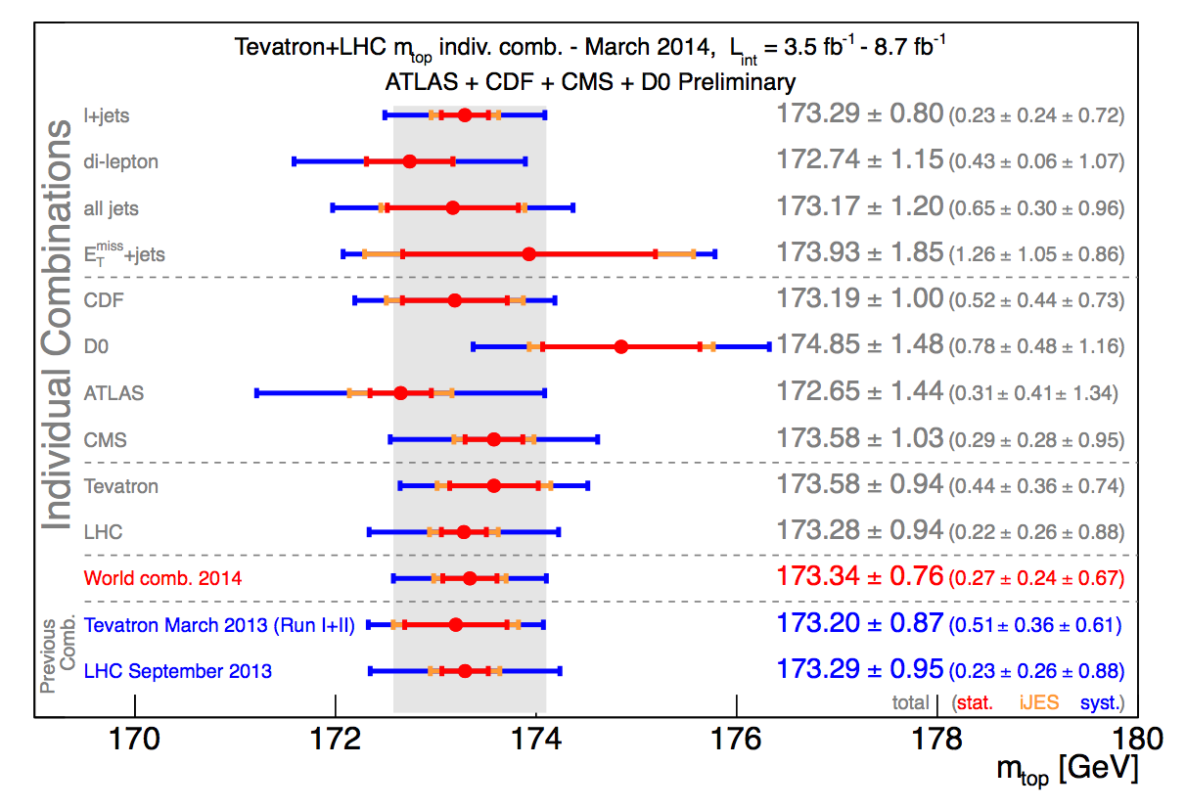
Top mass
First Tevatron-LHC combination
March 2014
arXiv:1403.4427

Slide 18
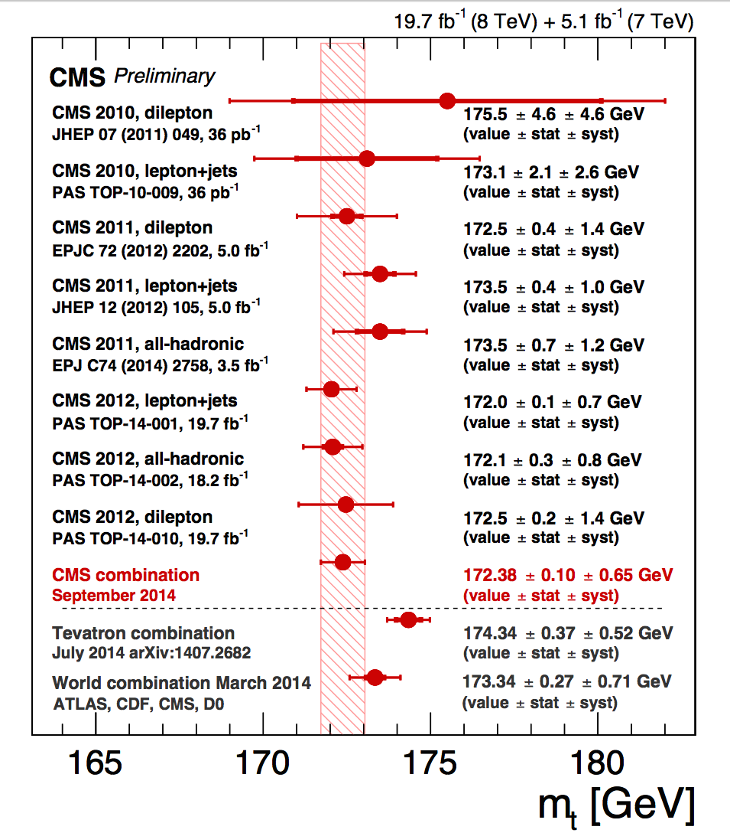
Standard methods
mass
CMS is the most precise experiment
7 TeV:
All published
(4 papers)
new
8 TeV:
1 legacy paper planned includes CMS 7+8 TeV combination
First blinded analysis in TOP
new
End of 2014 - TOP-14-022
(merges TOP-14-001/02/10/15)

Slide 19
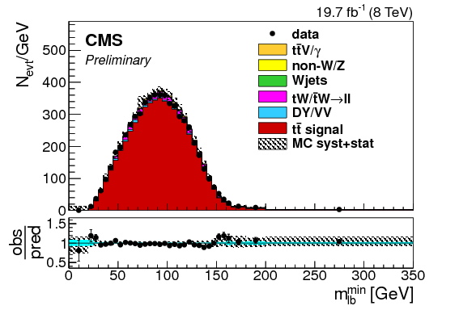
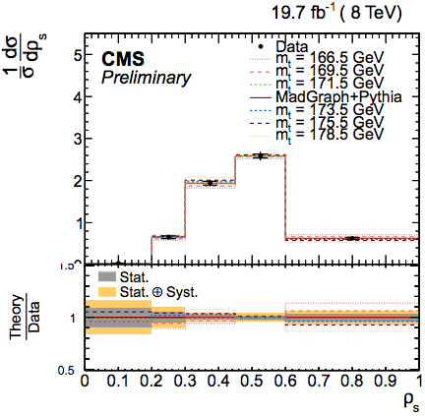
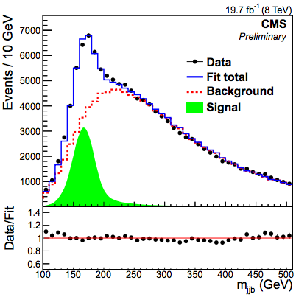
Alternative methods
mass
We also have a complete set of alternative mass methods
Goal: to improve our understanding of measured top observable
Already Published: mass from cross-section, mass from endpoints
Various PASes ready + new methods still being added
Normalized tt+1-jet cross-section
PAS TOP-13-006
Mass from m_{lb} (forward folding)
PAS TOP-14-014
“BEST” method
PAS TOP-14-011
new
in progress
in progress

Slide 20
Publication Plan
mass
Standard methods (7TeV all done)
TOP-14-022 Legacy Run I top mass (standard methods) (Fall 2014)
merges 14-001/02/10/15
PAS (4x) public, paper draft in preparation
Top/antitop mass difference (published at 7TeV)
TOP-12-031 Top anti-top mass difference at 8 TeV
POST CWR
Alternative methods
TOP-12-030 Top mass from B hadron life time (Fall 2014)
PAS public, improved method in development
TOP-13-007 Study of Underlying Event in top pair events (Spring 2015)
PAS public, work ongoing

Slide 21
Publication Plan (II)
mass
More alternative methods:
TOP-13-006 Top mass from tt+1 jet events (Fall 2014)
PAS pre-approved
TOP-14-011 Top mass using the BEST method (Fall 2014)
PAS pre-approved
TOP-14-014 Measurement of top mass from m_{lb}
PAS approved
TOP-XX-YYY Measurement of the top mass using kinematic endpoints at 8 TeV
Work ongoing
TOP-XX-YYY Measurement of the top mass using the J/psi method at 8 TeV
Work ongoing
Round table of publication plan and preparation for Run II
will occur next week during the top mass meeting

Slide 22
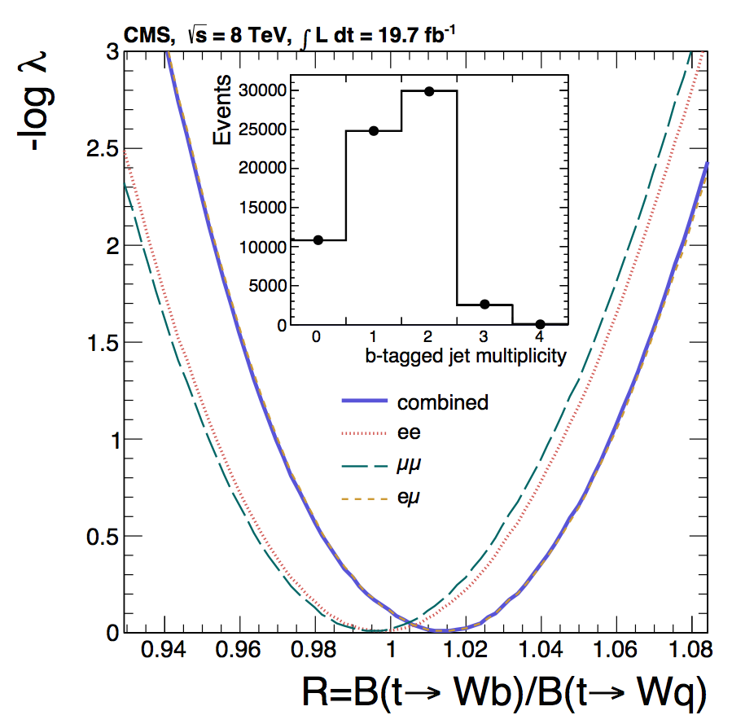
Top Properties
April 2014
Phys. Lett. B 736 (2014) 33
arXiv:1404.2292
Ratio R
B(t → Wb)/B(t → Wq)
8TeV, 19.7fb⁻¹
dilepton

Slide 23
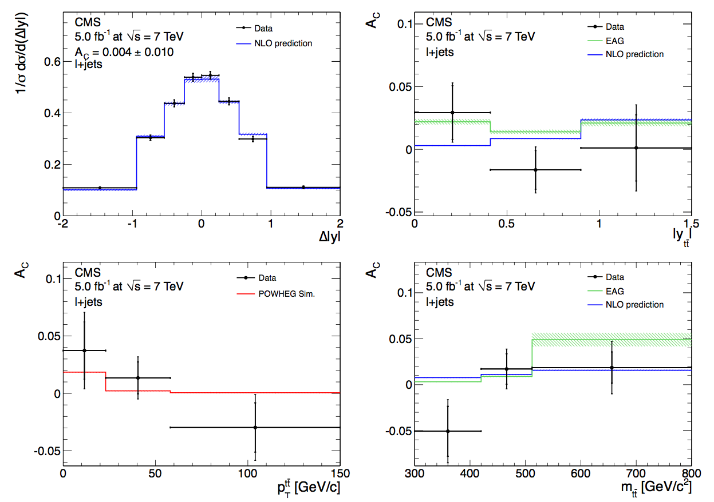
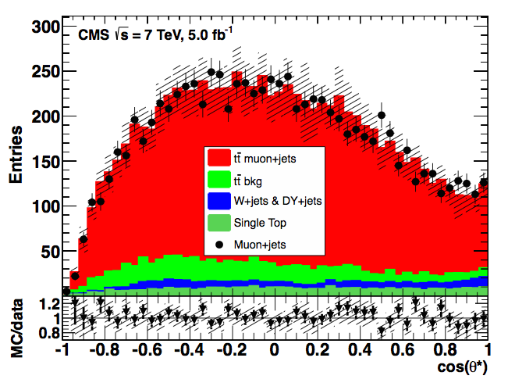
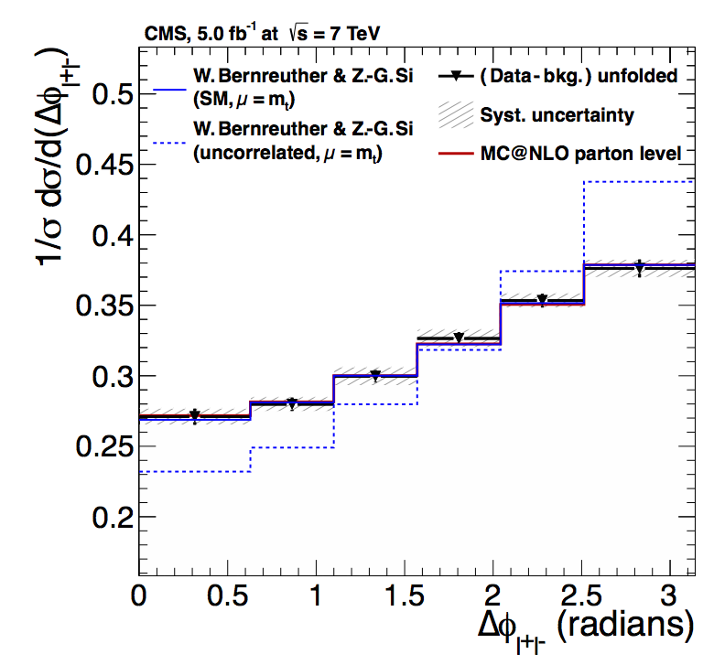
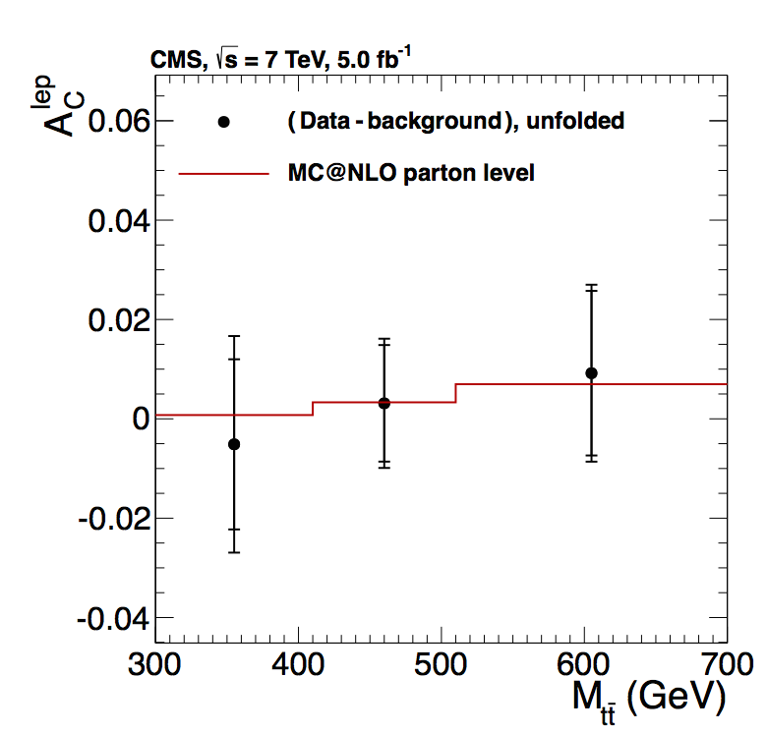
Angular distributions
Properties
June 2012
Phys. Lett. B 717 (2012) 129
arXiv:1207.0065
charge asymmetry, l+jets
August 2013
JHEP 10 (2013) 167
arXiv:1308.3879
W-helicity l+jets
November 2013
Phys. Rev. Lett. 112 (2004) 182001
arXiv:1311.3924
spin correlations and top-quark polarization
Dilepton
February 2014
JHEP 04 (2014) 191
arXiv:1402.3803
charge asymmetry
Dilepton

Slide 24
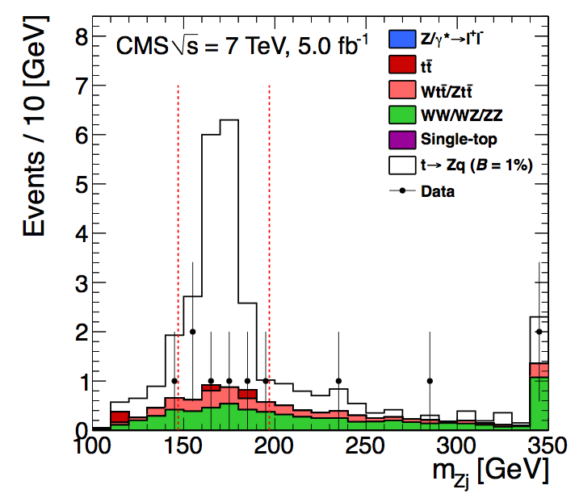
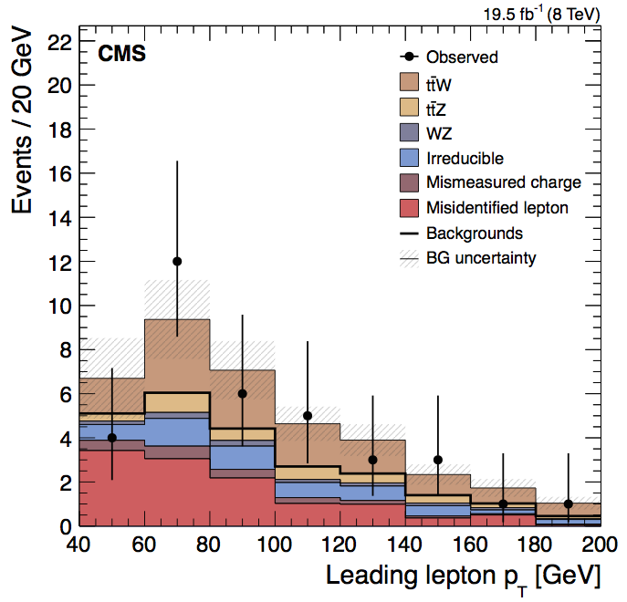
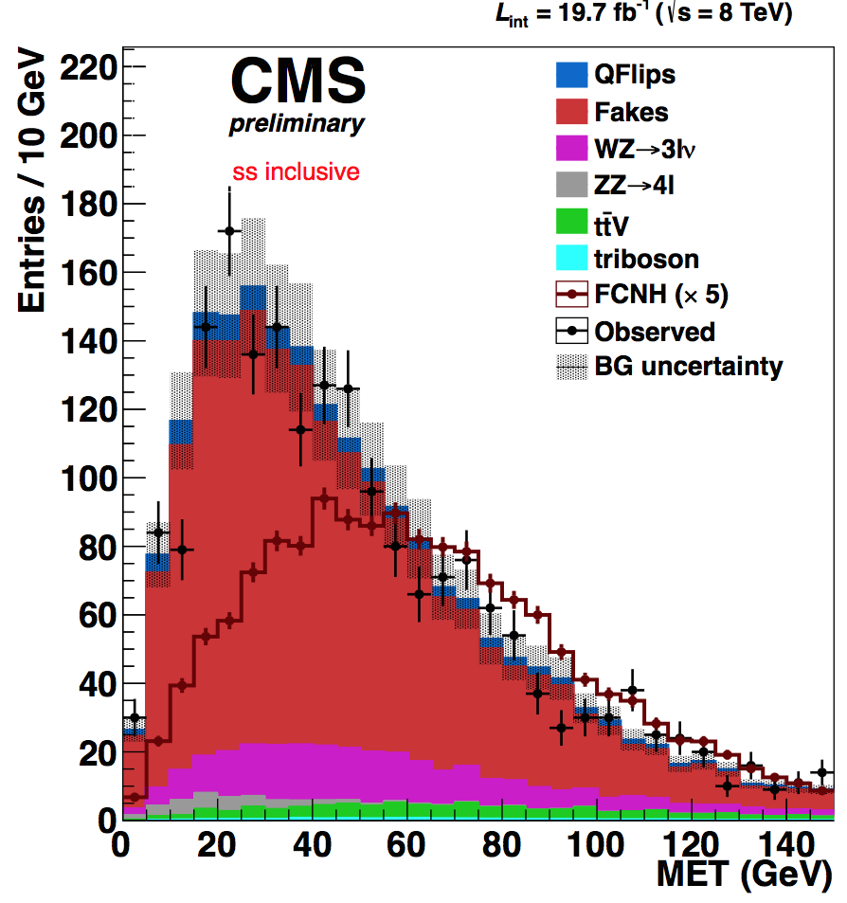
Everything else (FCNC, tt + X, t→X…)
Properties
August 2012
Phys. Lett. B 718 (2013) 1252
arXiv:1208.0957
FCNC tZq decay, 3 leptons
in progress
July 2014
Eur. Phys. J. C 74 (2014) 3060
arXiv:1406.7830
ttV, 4-lepton, 3-lepton, ss dilepton
19.5fb⁻¹
Search for flavor changing neutral Higgs (FCNH)
Three PASes, may be merged into one paper (tbd)
→ TOP-13-017 pre-approved yesterday
(multilepton H→ WW, ZZ,ττ)

Slide 25
Publication Plan
Properties
Charge asymmetry
TOP-12-033 Measurement of the ttbar charge asymmetry at 8 TeV (Fall 2014)
includes TOP-12-034
TOP-13-013 Determination of initial-state-dependent charge asymmetries in l+jet events at 8 TeV (Winter 2015)
W-helicities
TOP-13-008 W helicity and anomalous couplings (8 TeV, l+jets + 7/8 combined) (Winter 2015)
TOP-14-017 W helicity and anomalous couplings (8 TeV, dilepton + 7/8 combined) (Winter 2015)
Spin correlations
TOP-13-015 ttbar spin correlations using Matrix Element Methods (8 TeV, l+jets) (Winter 2015)
TOP-XX-YYY 8 TeV reprise of the 7 TeV dilepton analysis (TOP-13-003 for 7 TeV) including limits on top chromo moments (TOP-14-005 for 7 TeV)

Slide 26
Publication Plan (II)
Properties
tt+X
TOP-14-008 ttbar+γγ in l+jet and dileptons at 8 TeV (Winter 2015)
includes TOP-13-011
TOP-14-021 (?) tt+W/Z analysis for improved sensitivity
On going
FCNH
TOP-14-019 FCNH->γγ (Winter 2015)
merge with TOP-14-020 (FCNH->bb) and TOP-13-017 (multilepton H→ WW, ZZ,ττ) (tbd)
Other
TOP-XX-YYY Extraction of top pole mass, alpha_s from (differential) cross sections at 8 TeV (pole mass also could be a part of the cross section legacy paper)
TOP-XX-YYY Direct measurement of the Top Width

Slide 27
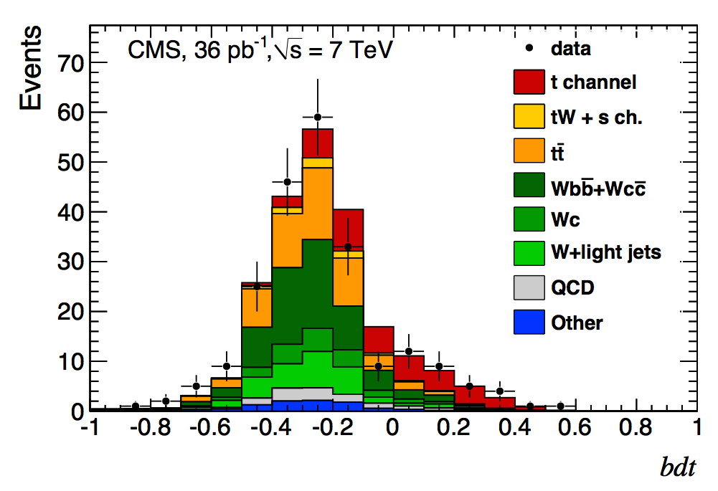
Single top
Jun 2011
Phys.Rev.Lett.107:091802,2011
arXiv:1106.3052
t-channel
36pb⁻¹
2D (cosθ* η_{j’}) and BDT
LHC Milestone

Slide 28
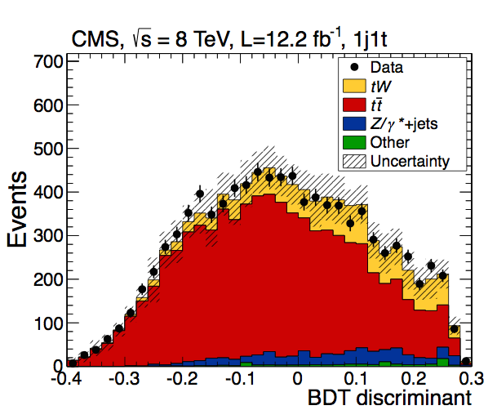
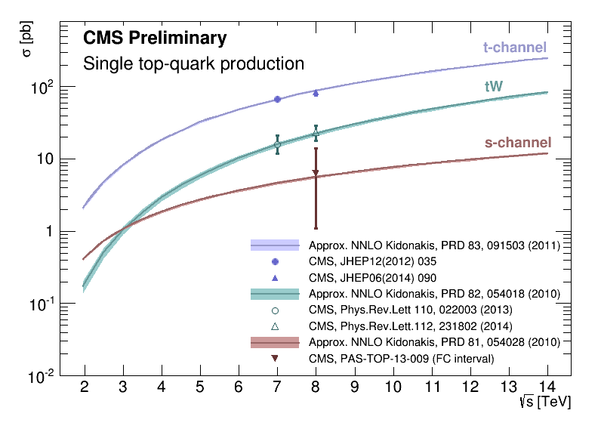
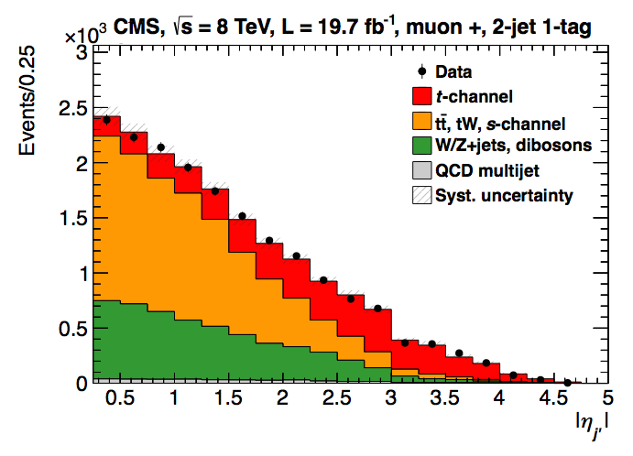
t-channel, tW, and s-channel
Single top
September 2012
JHEP 12 (2012) 035
arXiv:1209.4533
Observation
March 2014
JHEP 06 (2014) 090
arXiv:1403.7366
t-channel and |V_{tb}| η_{j’}
in progress
January 2014
Phys. Rev. Lett. 112 (2014) 231802
arXiv:1401.2942
tW (BDT, shape, cut) 6.1σ
September 2012
Phys. Rev. Lett. 110 (2013) 022003
arXiv:1209.3489
in progress
November 2013
PAS TOP-13-009

Slide 29
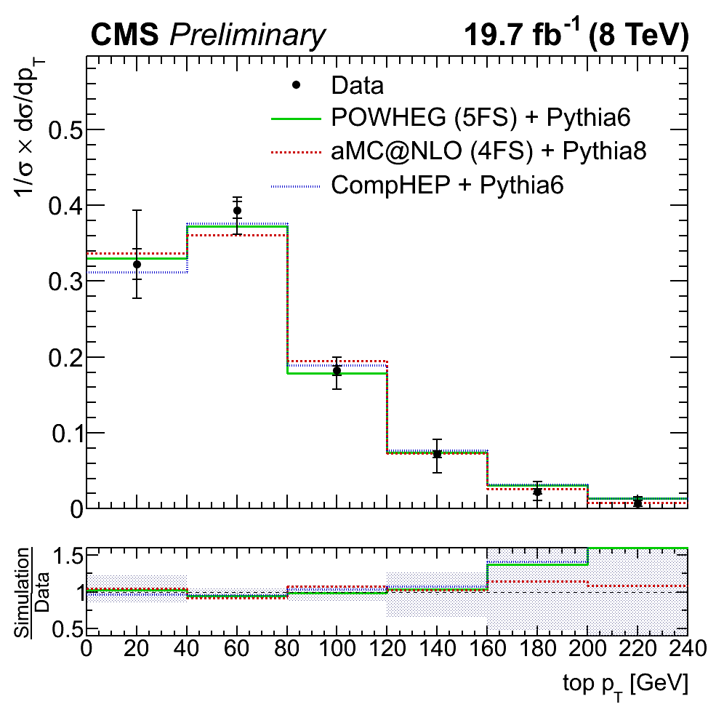

Most Recent – 8TeV 19.7fb⁻¹
Single top
September 2014
CMS PAS TOP-14-004
differential single top quark t channel cross sections
p_{T} and y
October 2014
Sub. to JHEP
arXiv:1410.1154
W boson helicity in t-channel
First CMS paper of top properties in single top
First CMS single top differential
t-channel well known, cross section well measured (inclusive and differential), already being used for measuring top properties (top polarization, W-helicities, mass)
FCNC and Anomalous couplings in different single top signatures also under study

Slide 30
Publication plans
Single top
TOP-13-001 Measurement of top polarization in single top (Fall 2014)
PAS public, t-channel, work ongoing
TOP-13-009 Single top production in the s-channel (Winter 2014)
PAS public, work ongoing
TOP-12-039 Search for FCNC in single top events at 8 TeV (Winter 2014)
PAS at 7TeV, tZq (FCNC and SM), work ongoing
TOP-14-003 Search for FCNC in single top events at 8 TeV (Winter 2014)
PAS public, tγ, work ongoing
TOP-14-007 Search for Anomalous Couplings and FCNC in single top events at 8 TeV (Winter 2014)
PAS public, t-channel, work ongoing
TOP-14-004 Measurement of single top t-channel differential cross sections
PAS public
Also ongoing:
Top mass in single top, t-channel fiducial cross-sections, tW l+jets

Slide 31

TOPLHCWG
Ongoing ATLAS+CMS effort to do LHC combinations, some of the combinations may be published
Top mass (post-legacy papers), single top…
CMS contact person for the TOPLHCWG:
Roberto Chierici
The contacts of the working groups are:
cross section: Maria Aldaya
single top: Luca Lista
top mass: Steve Wimpenny
W helicity: Mara Senghi
Charge asymm.: Thorsten Chwalek
Differential: Maria Aldaya
More info [Twiki]
First TOP LHC combination
July 2012
PAS TOP-12-001
Top mass combination

Slide 32


Latest
TOPLHCWG
September 2014
PAS TOP-14-009
tW combination, 8TeV
September 2014
PAS TOP-14-016
tt cross section, eµ, 8TeV

Slide 33
Summary
Top quark physics had a very prolific and successful Run-1
38 Run-1 TOP papers and 82 public PASes
Enormous amount of work already public
All info available in:
https://twiki.cern.ch/twiki/bin/view/CMSPublic/PhysicsResultsTOP
While we are getting ready for Run-2, we are not finished yet with Run-1
Many analyses ongoing
~38 new papers already planned
Several important publications are still to come
https://twiki.cern.ch/twiki/bin/viewauth/CMS/Internal/PublicationPlan2014#TOP
Some topics that could still be explored with Run-1 are uncovered, and some would profit from more manpower → Join us!

